Slide 1
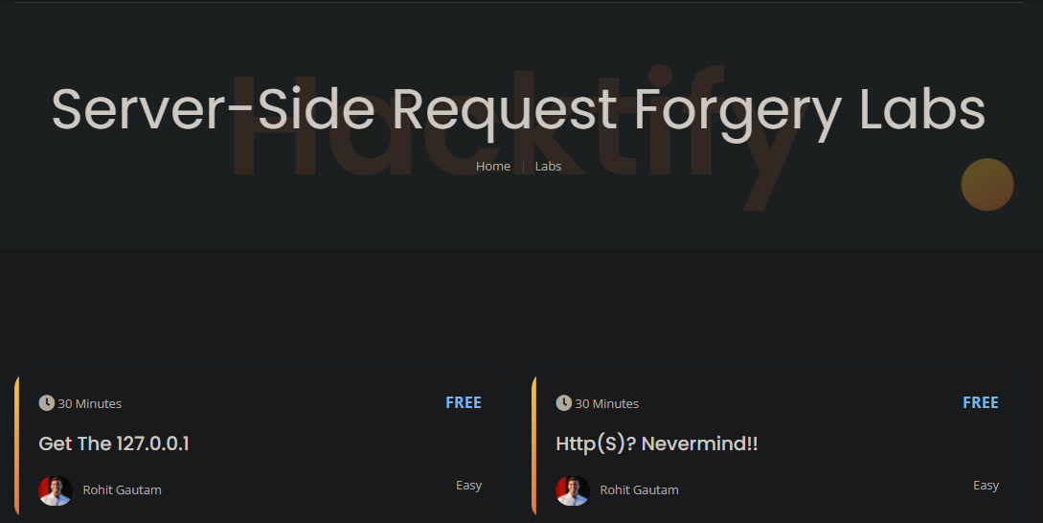
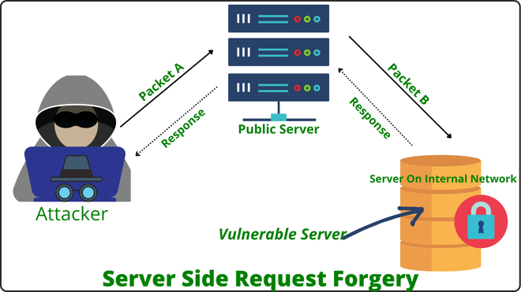

Week 7 as a Penetration Testing Intern
Server-Side Request Forgery (SSRF)
Exploitation techniques of SSRF
Hands on practice on SSRF
Severity, risks, impact, and prevention of SSRF
Server-Side Request Forgery
Virtually Testing Foundation

